Slide 1
Brief History of the Romanian Local Traditional Cuisine
ALLPPT.com _ Free PowerPoint Templates, Diagrams and Charts

Slide 2
General presentation
Much as the country’s culture, Romanian gastronomy reflects its wide and varied history. From the ancient times, the food providing activities of Romanian habitants were agriculture, animal growth and hunting, so the Romanian cuisine has always benefit from a wide variety of traditional meat products, cheese and vegetables.

Slide 3
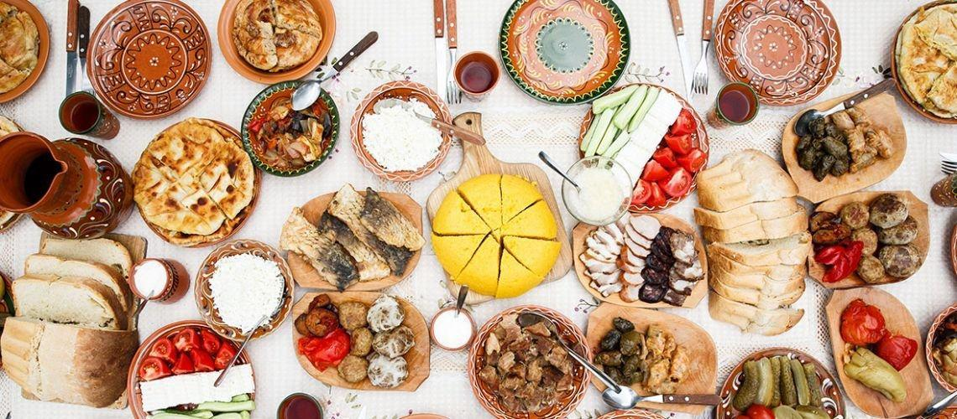
History
Over the time, giving the continuous migration and domination of various other nations, such as Ottoman Empire, over Romanian territory and the mix of cultures,
Romanian cuisine has been influenced by the Balkan cuisine, the Turkish, the German, the Italian, and the Hungarian dishes. Even today there is a lot of western influence over the Romanian food.

Slide 4
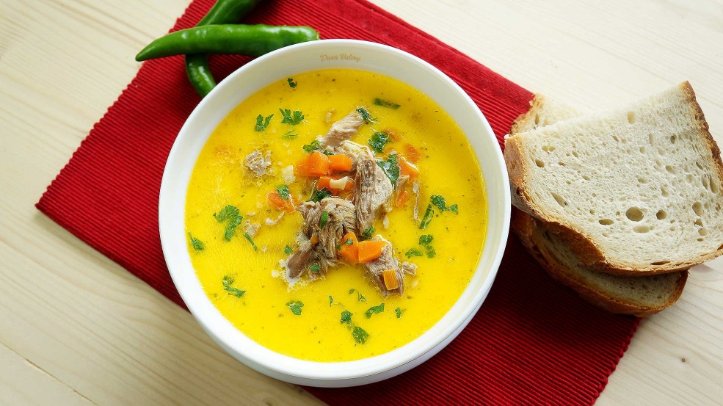
The soups, often sour with cabbage juice or vinegar, are seasoned with egg and cream. Paprika, goulash soup are dishes present in this area. But not only the cuisine from the western part of the country underwent western influences, but also the southern one.

Slide 5
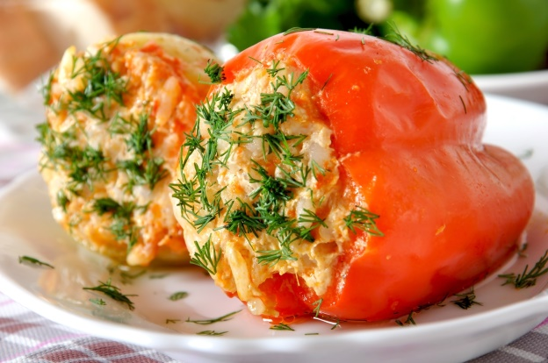
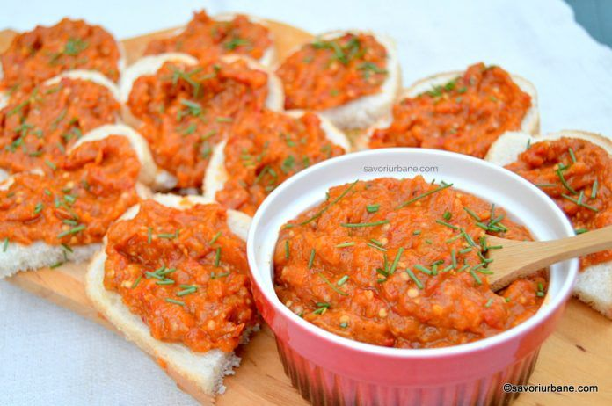
Romania’s gastronomic culture inherited numerous culinary habits from its invaders and neighbours: the Romans were responsible for the pie, the Turks for ciorba de perisoare (meatball soup), chiftele and ardei umpluti (stuffed peppers), the Greeks for moussaka, Austria brought the delicious schnitzel, and the Bulgarians the various vegetable based dishes, like zacusca, a very popular mix of boiled vegetables prepared during autumn time.

Slide 6
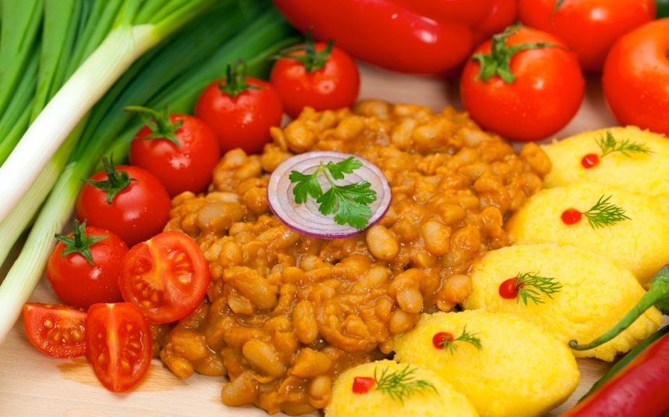
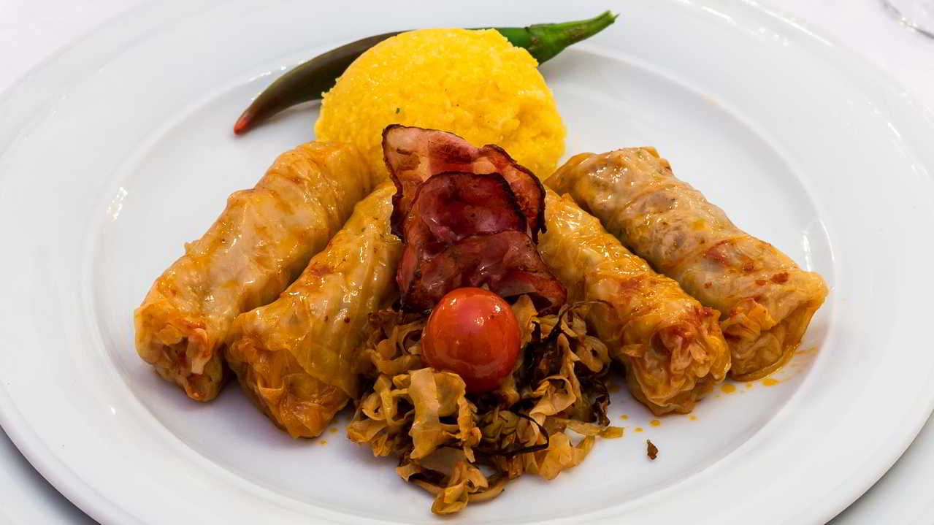
One of the traditional meals is mamaliga, a type of polenta, mostly made of maize flour, water and salt. It was used in the past as a substitute for bread, but today we can find it in most traditional Romanian restaurants, next to pork, beef or lamb dishes, Romanian cheese and sausages.

Slide 7
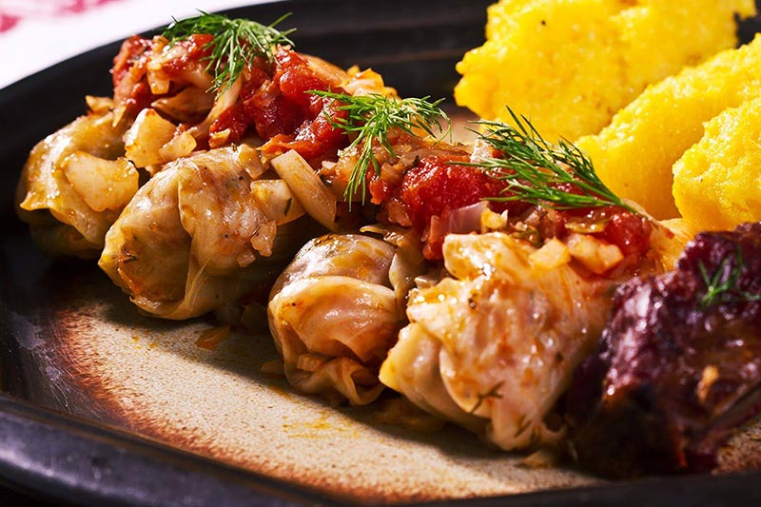
Romanian dishes that everyone should try Sarmale (Cabbage Rolls)
Considered to be Romania's national dish, these stuffed cabbage rolls are actually of Turkish origins.
The initial recipe was strongly modified over time until it reached what is considered to be now the perfect stuffing. A balanced mixture of rice and minced meat (usually pork or pork combined with beef) and other vegetables and local herbs is rolled in cabbage leaves or young grape leaves for a delicate flavor.

Slide 8
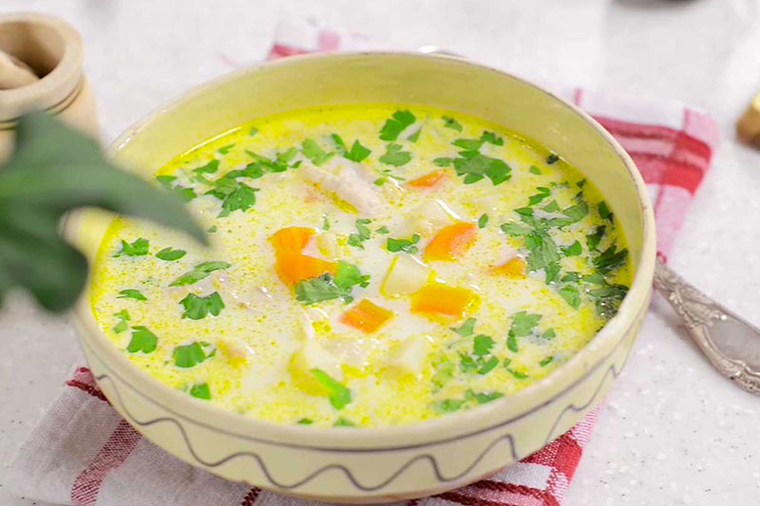
Ciorba Rădăuțeană (Rădăuți Soup)
Ciorbă refers to a type of traditional soup which can be served in many different ways, depending on the ingredients used. But the one called rădăuțeană is among the most appreciated in Romania.
To keep it simple, this dish has plenty of sour cream and garlic in it, and for the specific sour taste, vinegar is used. It's a delicious soup, not too fatty and not too heavy either, but a whole meal in itself.

Slide 9
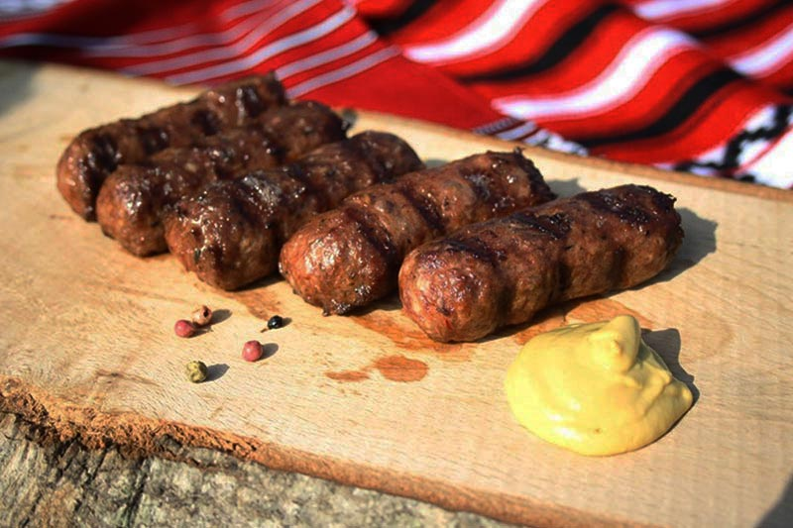
Mici
Also known as mititei, they are the most popular Romanian grill dish, and they are so loved that there is absolutely no Romanian who can imagine a proper barbecue without them. These caseless sausages are made of different combinations of ground meat, black pepper, and other spices, and they are grilled until they darken a little and become moist and soft.
They are served simply with mustard and bread. You can find mici in restaurants, in fast foods, in street food shops or you just can buy the mixture from any grocery store, fresh or frozen, ready to be grilled or fried whenever you feel like it.

Slide 10
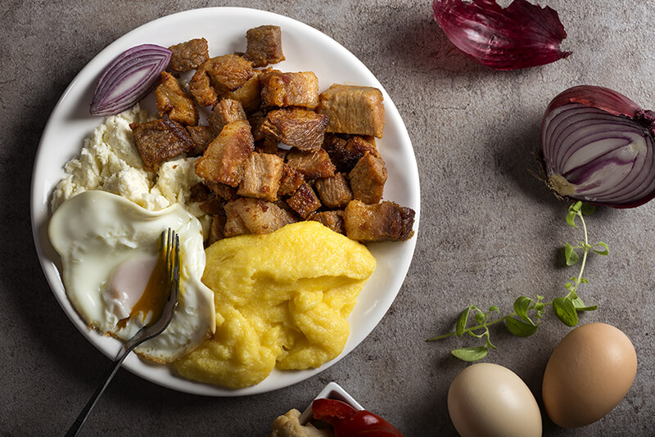
Tochitura moldoveneasca (Moldavian Stew)
There is nothing like the famous Moldavian stew, and there is no exaggeration in saying that this is the ultimate Romanian dish, as it combines the best traditional foods Romania has to offer: mamaliga (polenta), traditional salty fermented cheese, fried eggs, fried pork, traditional sausages, and pickles. It's the perfect combination of tastes and textures.
The stars of this traditional dish are the pork and sausages, which are best cooked over an open fire in a cast-iron stew pot, but they can also be fried in a skillet. Over the delicious meat is then added white wine, tomato paste, onions, garlic, and bay leaves.

Slide 11
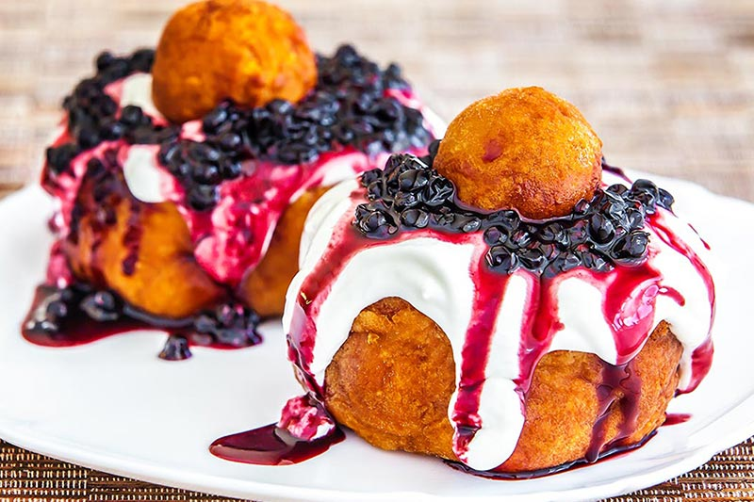
Papanași with sour cream and jam
A traditional dessert originating from the northern part of the country but popular among all Romanians, being available in almost every restaurant.
Papanasi are a kind of fried cheese doughnuts best served hot, with sweet and sour cream, and preferably, blueberry jam. Maybe it doesn't sound too appetizing but the taste and the gummy texture combined with the blueberries’ sourness is absolutely divine!

Slide 12
Conclusion
Although less known around the world, Romanian cuisine is always a nice surprise for tourists, getting numerous appreciations from those who are eager to try it. It may look familiar at a first glance, but most of the time, a Romanian dish can have a unique taste, giving the spices and the methods of cooking used in this country.

Slide 13
Thank you for your attention!
ALLPPT.com _ Free PowerPoint Templates, Diagrams and Charts

