Slide 1
Traditional Medicine in Romania

Slide 2
The Romanian traditional medicine has a long history because it was the means by which people could treat diseases in the days when modern medicine was less developed.
Traditional medicine was an alternative for people to be treated in times when modern medicine was not as advanced. For different reasons, sometimes, people even today prefer not to go to the doctor, especially if their families have a tradition of caring at home.
Each community had specific natural remedies, based on the geographical area, environmental conditions and other factors. Thus, the use of plants can be considered as part of the intangible cultural heritage of each community.
.

Slide 3
Traditional use of medicinal and aromatic plants

Slide 4
The medicine that first of all we have at your fingertips, is the tea. The tea was always been considered by the Romanians a cure for the sick. Only in recent years, the tea has become an opportunity to chat and socialize. But traditionally, the tea treats diseases of the heart, the pain of any kind, nervousness, upset stomach; all diseases can be cured thanks to the tea.
Plants are considered by the Romanian people living beings who hear, see, feel, suffer, have souls.
The secret is to know which tea can help you with your problem. For example, St. John's wort for gastritis, linden to calm down, the mint for the indisposition of the stomach, camomile is efficient and is a disinfectant in cases of colds, the tamarisk can be used for vitamin deficiency and yarrow for bronchitis.

Slide 5
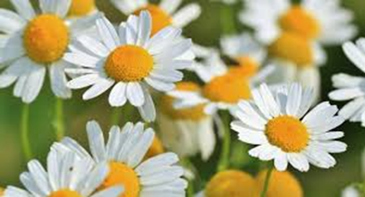
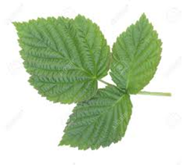
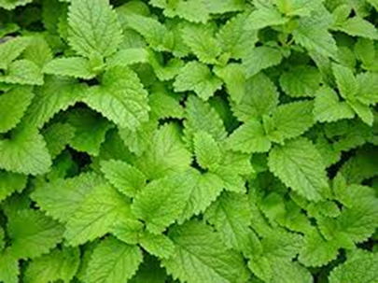
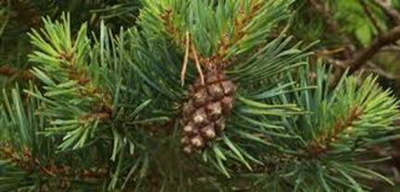
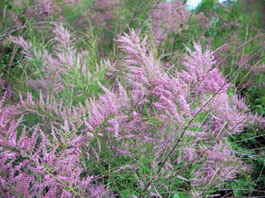
Camomile
Raspberry leaves
Mint
Pine
Tamarisk

Slide 6
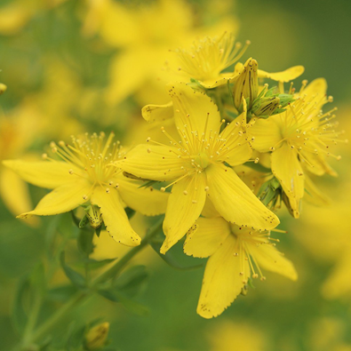
St. John’s Wort Plant
It was believed that harvesting the plant in holy days would give it greater powers. The perfect harvesting day was June 24, the birthday of Saint John the Baptist, which is, in fact, most of the time, the period of maximum flowering of St. John's wort.
This plant is used as a diuretic and for the treatment of wounds and hemorrhoids, kidney and lung disease, digestive system diseases, for wound healing and pain relieving.

Slide 7
Popular Wisdom
Also popular wisdom asserts the importance of maintaining relations with the Earth. Farmers often walk barefoot in summer, especially mowing and their houses have ground on the floor and on the porches. Summer is good for children to be allowed to walk barefoot, like walking for ages the peasants‘ children. As their connection with the nature is more direct during the summer, the better they will be protected from all diseases in winter.

Slide 8
The category of traditional treatments also includes spells, a method that is seen less and whose results are less obvious in a direct way. Spells are verses or words spoken by an elderly woman, called exorcist or witch. During some spells, they light up matches. The spell removes the sufferings from the sick person and sent them to places never known or seen by humans. One of the most common cases when the spells are made is the evil eye. When the beauty and the health of a person aroused envy or there was an incompatible look, it is said that this person took the evil eye.
At the same time, Romanians have some beliefs for what concerns the origin of the disease, among which the most famous is that the diseases are of the devil. Therefore, to treat them are invoked God, the Virgin Mary, the saints, but is also very important the role of the priest and the candle from Mass Resurrection of Jesus Christ. Garlic, pepper and basil are also part of the means of protecting the health and luck, keeping the evil spirits away from the people.

Slide 9
Bee Medicine

Slide 10
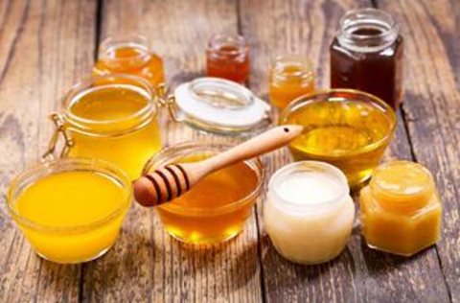
Bees have been a source of alternative medicine since ancient times and Romania is keeping the tradition alive.Beekeeping is an important traditional occupation.

Slide 11
Honey is a complex food, one of the healthiest: it contains vitamins, organic acids, minerals and enzymes from bees thanks to which honey is considered a superfood.
Bee venom is used to combat multiple sclerosis, pollen for indigestion, honey to heal wounds.
Propolis is used against sore throats, as well as honey and pollen to boost the immune system.

Slide 12
Salt Mines

Slide 13
Miners dug hundreds, even thousands, of feet into the ground, extracting one of humanity's most treasured minerals: salt. After extracting its treasures, miners left the mine but left behind incredible passages as tall as cathedrals.
The Romanian salt mines are located between low altitude hills, of 500-700 m, in a gentle continental climate. Considering the admission of the saline treatment efficiency, mostly in pulmonary diseases, the development of this type therapy in Romania is presently in continuous development.
Asthma cure is very dependent upon traditional alternative medicine procedures. The onset of modern medicine has not replaced traditional asthma cure because of its popularity and reported success rates.

Slide 14
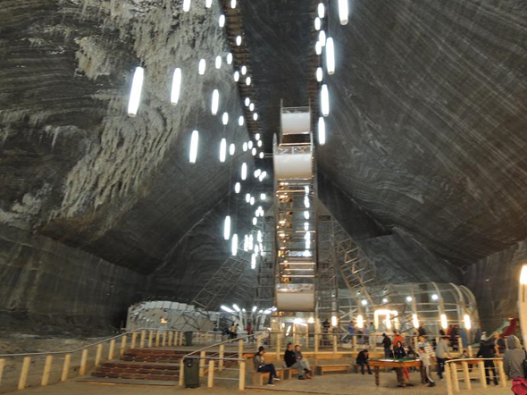
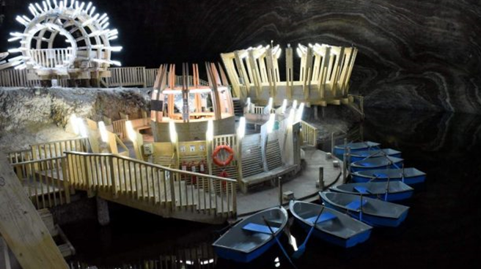
Turda Salt Mine was dug during Middle Ages for salt exploitation. Now is one of the most visited sights in Romania.
It was renovated between the years 2008-2010. Therefore, some standards of modern visiting, were included. An elevator with bird’s eye-view was installed, a wheel with gondolas. A recreation space with wharf was created in which tourists can boat.

Slide 15
Traditional medicine is the knowledge, skills and practices based on the theories, beliefs and experiences indigenous to different cultures, used in the maintenance of health and in the prevention, diagnosis, improvement or treatment of physical and mental illness.
There are many different systems of traditional medicine, and the philosophy and practices of each are influenced by the prevailing conditions, environment, and geographic area within which it first evolved.
A common philosophy is a holistic approach to life, equilibrium of the mind, body, and the environment, and an emphasis on health rather than on disease. Generally, the focus is on the overall condition of the individual, rather than on the particular disease from which the patient is suffering, and the use of herbs is a core part of all systems of traditional medicine.

Slide 16
Thank you for your attention!

